Slide 1
Donco in Niger
BUDT758Z – Track 0501
Roma Kaul (Regulation, Recommendation, Security)
Akshar Krishnamurthy(Country Profile, Recommendation, Security)
Anshul Uchil (Wireless, Recommendation, Security)
Deepthi Viswanath (Wireline, Recommendation, Security)

Slide 2
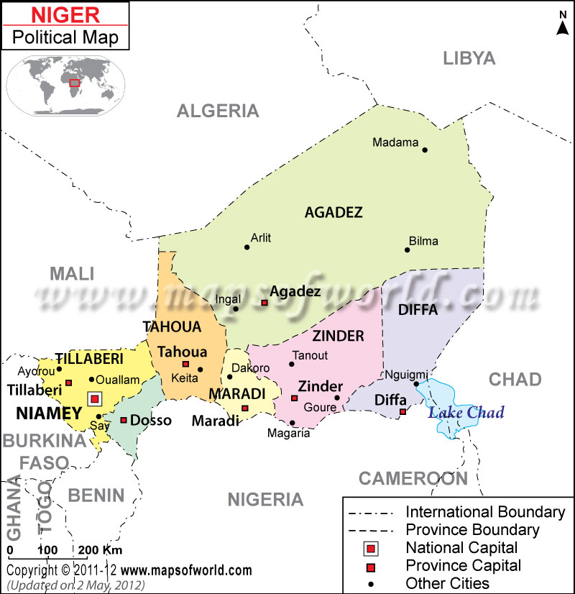
Country Profile
Area (sq km): 1,267,000
Population 2015 (million): 19.6
Households 2015 (million): 2.2
Capital: Niamey
Language: French (official), Hausa, Djerma
Exchange rate annual average (2015):
USD 1 = XOF 619.18
GDP 2015 (USD billion): 8.17
GDP per capita 2015 (USD thousand): 0.3

Slide 3
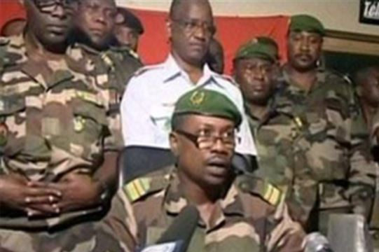
Political Profile
Niger has a history of Political Instability.
Niger was under the French rule till Aug 1960.
Succession of military coups from mid 1970’s.
Two major insurgencies by Tuareg rebels in 1990
and 2007.
Niger Movement for Justice (MNJ) responsible
for the most recent uprising.
Constitutional crisis in 2009, which was caused by Tandja's efforts to remain in office beyond the originally scheduled end of his term.
Mahamadou Issoufou has been the President since 2011 but the political situation is pretty volatile with elections scheduled to take place in 2016.

Slide 4
Economic Development
Niger was rated by the UN as the world’s least developed nation in 2014.
Food insecurity, lack of industry, high population growth, a weak educational sector and few prospects for work.
Subsistence farming and herding contributes about 40% of GDP and provides livelihood for about 90% of the population.
Leading producer of Uranium.
Cotton, the nation’s main cash crop, suffers erratic production levels partly due to recurring drought.
Inflation topped 12% in 2009 as the food shortage increased prices.

Slide 5
Regulations
In Niger, the telecom network companies need a license, which needs to be approved by ARTP to operate in the public.
The requirements for approval is subject to the compliance of the equipment and independent networks with endpoints separated by less than 300m and links with a capacity of less than 2.1Mbps, can be operated and established freely.
In 2012, ARTP awarded three 15-year GSM licenses at a cost of USD5.8 million each to three main providers.
ARTP has authorized broadband license to 6 big companies for carrying out the services.

Slide 6
Wireless
A rising population of approximately 17 million and a wireless penetration of only around 38%.
This means there are good prospects for future growth.
demand for mobile telephony services in Niger is booming
Annual subscriber growth averaged 70% in the four years to end-2008, before gradually slowing to an average rate of 23% in 2011/12

Slide 7
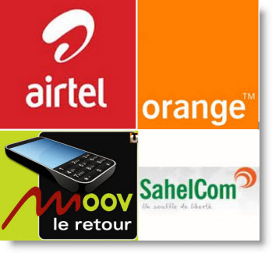
Major Wireless Players
Airtel Niger (57.8%)
Orange Niger (28.2%)
Moov Niger (9.6%)
SahelCom (4.5%)

Slide 8
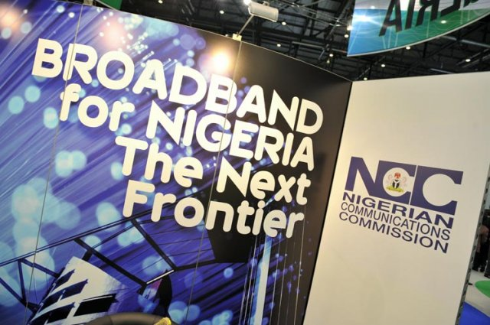
Broadband
Niger has around 10750 Broadband
Subscribers.
Low household penetration of 0.5%.
Due to limited backbone capacity,
Niger relies on expensive satellite
communications.
This resulted in High local and international
telecom costs, limited bandwidth capacity
and Interoperability problem among carriers.
Government investing in building a fiber optic backbone network.

Slide 9
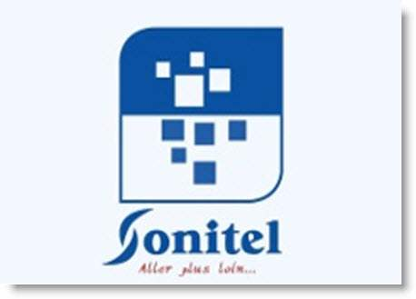
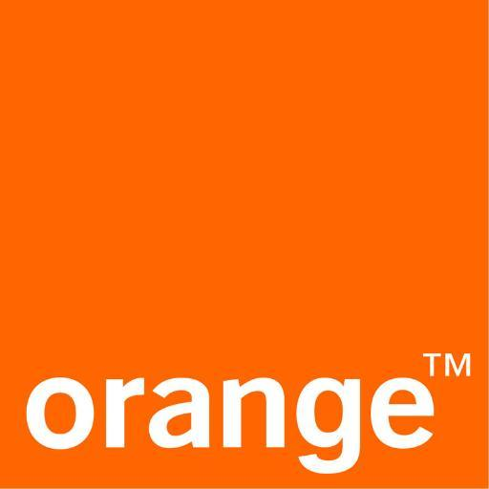


Major Broadband Players
Sonitel
Orange Niger
Alink Niger
Liptinfor

Slide 10
Recommendation (Speed)
No need for high speeds due to small businesses present in Niger.
Approximate speed required: (10*1024*8)/(60*60) = 23 kbps.
Speed we would consider taking into account
the possibility of expansion : 100kbps.
A connection speed of 128 Kbps would be sufficient.

Slide 11
Recommendation (Location)
The main location for setting up base should be the capital Niamey.
It has a strong backbone network consisting of fiber optics and all the future development plans going to take place has included the capital.
In addition, we recommend Zinder, second largest city in Niger after the capital itself as a secondary location base for DonCo suppliers as it has all the latest services and major providers of Niger coverage.
Arit, Agadez and Maradi are also feasible locations as Orange Niger offers Wi Max services to these locations.
A few other smaller cities are also feasible depending on the requirements.

Slide 12
Recommendation (ISP)
Orange Niger with highest priority for 5 major cities as it provides WiMax-802.16e service.
This technology being faster and more reliable than the others available in these cities makes it our first choice.
We recommend Sonitel For the other smaller cities like Birni, Kollo etc as the ADSL service provided is reliable and cheaper.
3G servies being unreliable in this country we recommend we stick with these 2 providers only.

Slide 13
SWOT Analysis (Airtel)
Strength
Largest wireless provider
Dominates 58% of the market
Available in almost all cities in Niger
Fast expanding 3G networks with relatively cheaper packages.
Weakness
Prices are still expensive and expansions are not complete for 3G.
Cases of poor management and failure to abide by contract rules
Fined once for irregularities in charging customers and not meeting conditions.
3G services are not the most reliable form of Internet.
Opportunity
Since it got its license for 3G progress has slowed and if it is able to offer faster speeds at better prices it could completely dominate the market.
Threat
Not yet as established as Orange as with regards to 3G.
SWOT

Slide 14
SWOT Analysis (Sonitel)
Strength
Most reliable wireline provider.
Provides internet to 40+ cities and currently has contracts with a number of countries to lay fiber optics backbone network in Niamey.
Weakness
Still depends mostly on copper lines with fiber optic progress being slow.
Relatively high costs considering the modest speeds being provided.
Opportunity
Numerous deals with countries to replace copper lines with fiber optic backbone for main cities and neighboring countries.
Threat
Repeated failures at privatization due to poor management
Failure to meet contractual obligations Lack of competition from other providers.
SWOT

Slide 15
SWOT Analysis (Orange Niger)
Strength
Offer Wi-Max, which is the latest technology offered amongst large-scale competitors.
Cover largest cities in Niger where maximum internet users are located.
Weakness
Prevalent only in few major cities.
Opportunity
Could expand to more countries, thus creating a larger customer base.
Also looking likely to break the monopoly of Sonitel with its customer base and technology provided.
Threat
Still not properly established amongst home owners.
SWOT

Slide 16
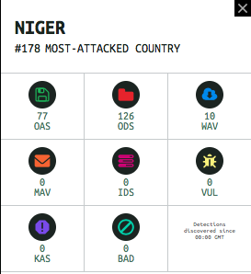
Cyber Security
Niger has been relatively immune to cyber-attacks as compared to other countries, in spite of minimal steps taken by the government to counter cyber-attacks.
Access controls and firewalls are of the utmost importance as we do not want intrusion in DONCO corporate data systems.
User training should be made mandatory and encryption should also be used for very critical data.

